Slide 1





Slide 2


What is CA Accelerator?
The CA Accelerator is an internal incubator program which allows intrapreneurs to receive support and funding in order to get exciting, new innovations to market.
Following lean start-up principles, we experiment continuously, solve problems as we go and keep customers involved at every stage because we know that great ideas only matter when they lead to solutions customers use.
Copyright © 2018 CA Technologies. All rights reserved.

Slide 3




Copyright © 2018 CA Technologies. All rights reserved.

Slide 4

What is Code Pilot?
Code search tool for software developers, that keeps you coding and allows you to get quick, easy access to the code, issues, errors, and learning you need.
Created by a dedicated team of developers and entrepreneurs who noticed a need for faster, better code search and decided to create the solution.
Copyright © 2018 CA Technologies. All rights reserved.

Slide 5

How does it work?
It uses resources such as your local folders, GitHub, SearchCode, YouTube and StackOverflow to gather answers to your coding questions.
CodePilot processes the results with powerful machine learning so you can find exactly what you are looking for in little time.
Code Pilot supports Linux, Windows, and Mac and integrates with a wide variety of platforms, including Stack Overflow, GitHub, search engines, and custom data stores.
Copyright © 2018 CA Technologies. All rights reserved.

Slide 6
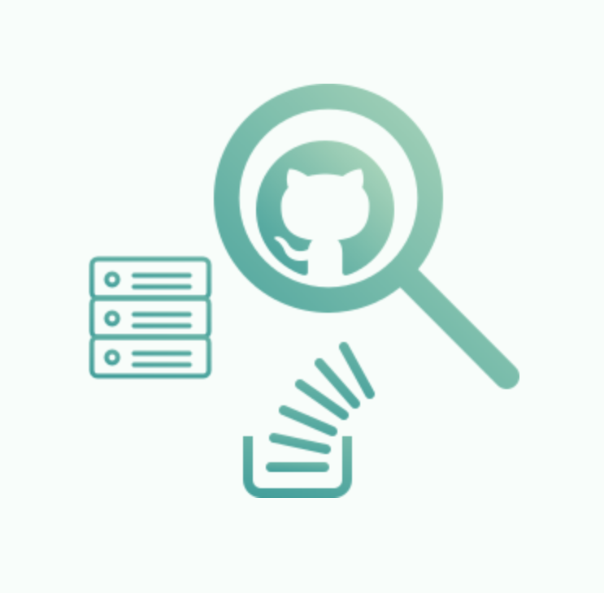
Customize your searches
Code pilot learns what you need based on what you searched for, it uses machine learning to tailor smarter results to you.
Search precisely for what you want including or excluding terms, using “AND” and “OR” searches, and specifying whether you want only exact matches.
You can eliminate GitHub, Stack Overflow, or local search results, and you can choose whether to search GitHub Code, GitHub Commits, or GitHub Issues… or a combination of all three.
Copyright © 2018 CA Technologies. All rights reserved.

Slide 7

Teach yourself
Teach yourself something new through the use of tutorials, documentation, videos and much more.
This is carried out through custom sources like CodeSandbox.io, CodePen.io, and many more.
Copyright © 2018 CA Technologies. All rights reserved.

Slide 8
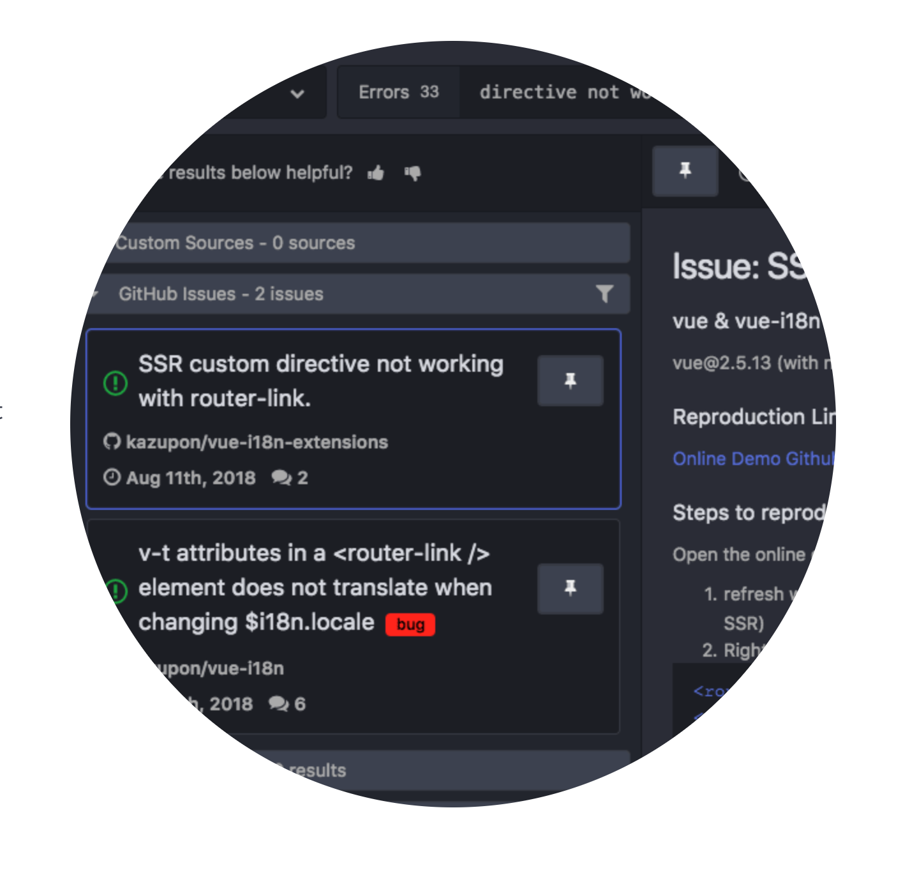
Tackle Errors
Having problems with an error message?
Describe your error and CodePilot might find your solution.
Search through issues and commits from GitHub and
Stack Overflow to find the best solutions to your coding issues.
Copyright © 2018 CA Technologies. All rights reserved.

Slide 9
Code search made easier
Get quick, easy access to the code, issues, errors, and learning you need.
CodePilot is a great tool for every developer.
NO more having to juggle between numerous tabs in order to find the answers to your coding questions.
Copyright © 2018 CA Technologies. All rights reserved.

